Slide 1

WELCOME
Bienvenidos
Parking Solutions Meeting
Wednesday, January 13, 2016

Slide 2

Agenda
6:30 – 8pm
Presentation/ Presentación
Questions/ Preguntas
Small Group Discussion/ Grupo de Diálogo
Highlights/ Opiniones
Upcoming Events/ Próximos Eventos

Slide 3

County Efforts on Parking
Notes:
- Brief background on these dialogues
- Thanks to sponsors
- Describe dialogue purpose:
learn more about the topic of parks, gardens and green spaces
have an opportunity to share your thinking about this topic and hear from others what they think
consider how you can promote access to parks and green spaces in NFO
- Invite to next dialogue (August 12, 2015)

Slide 4
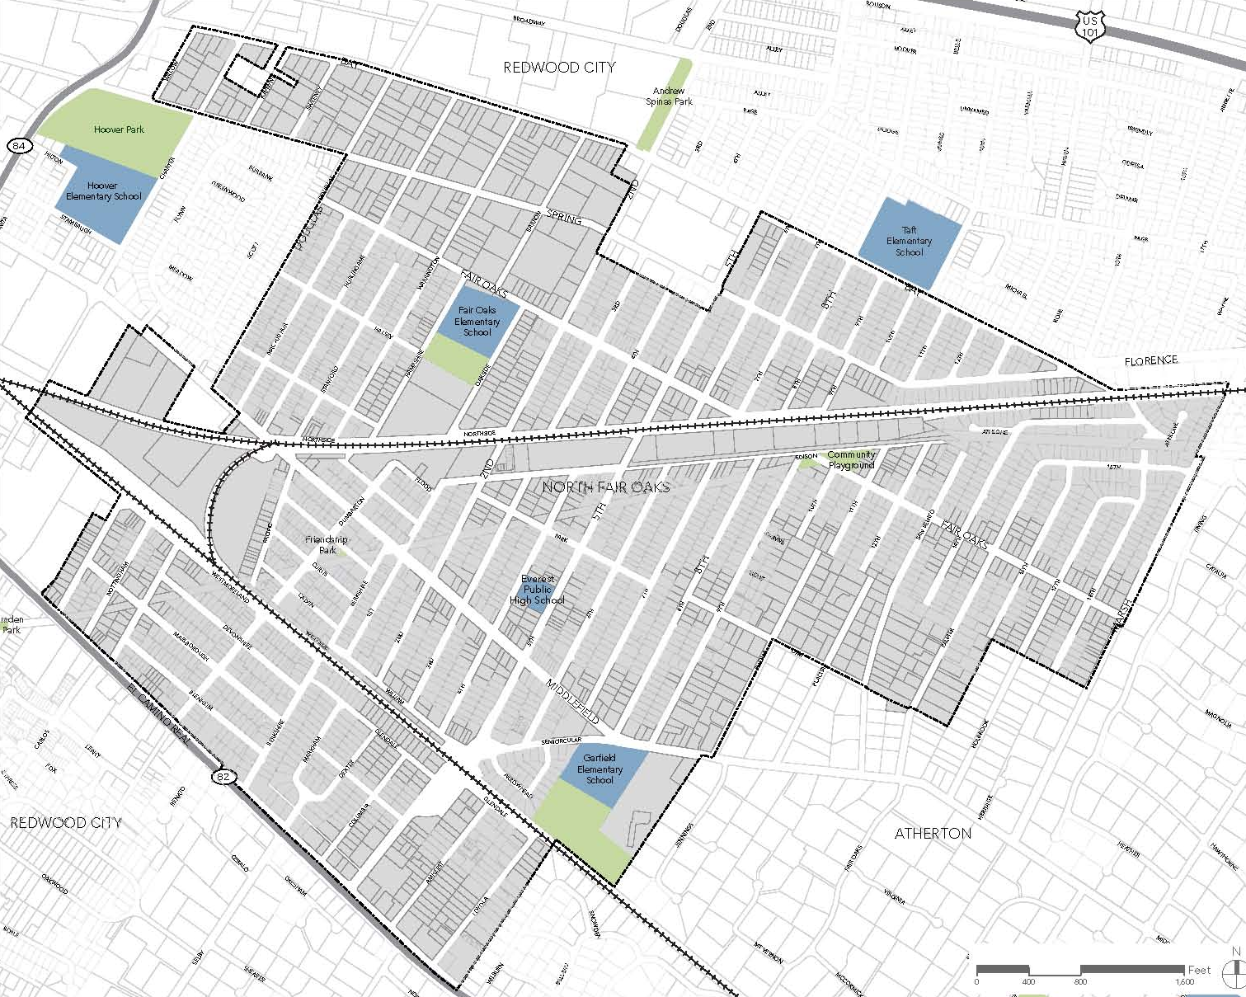
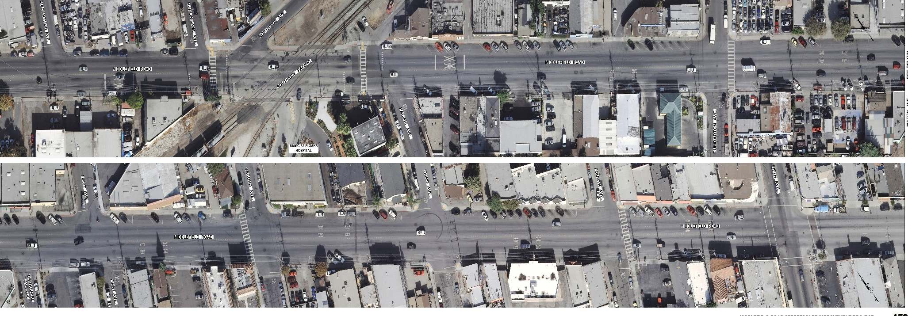
North Fair Oaks:
Middlefield Road
Notes:
- Brief background on these dialogues
- Thanks to sponsors
- Describe dialogue purpose:
learn more about the topic of parks, gardens and green spaces
have an opportunity to share your thinking about this topic and hear from others what they think
consider how you can promote access to parks and green spaces in NFO
- Invite to next dialogue (August 12, 2015)

Slide 5
Conceptual Design
Will add visual…
Notes:
- Brief background on these dialogues
- Thanks to sponsors
- Describe dialogue purpose:
learn more about the topic of parks, gardens and green spaces
have an opportunity to share your thinking about this topic and hear from others what they think
consider how you can promote access to parks and green spaces in NFO
- Invite to next dialogue (August 12, 2015)

Slide 6
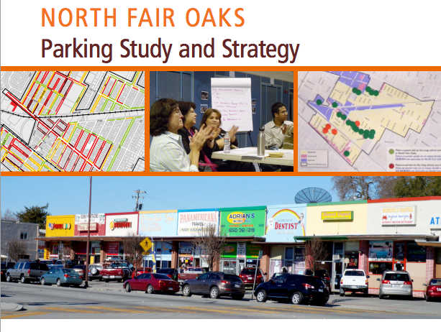
Parking Study – Further Analysis
Notes:
- Brief background on these dialogues
- Thanks to sponsors
- Describe dialogue purpose:
learn more about the topic of parks, gardens and green spaces
have an opportunity to share your thinking about this topic and hear from others what they think
consider how you can promote access to parks and green spaces in NFO
- Invite to next dialogue (August 12, 2015)

Slide 7

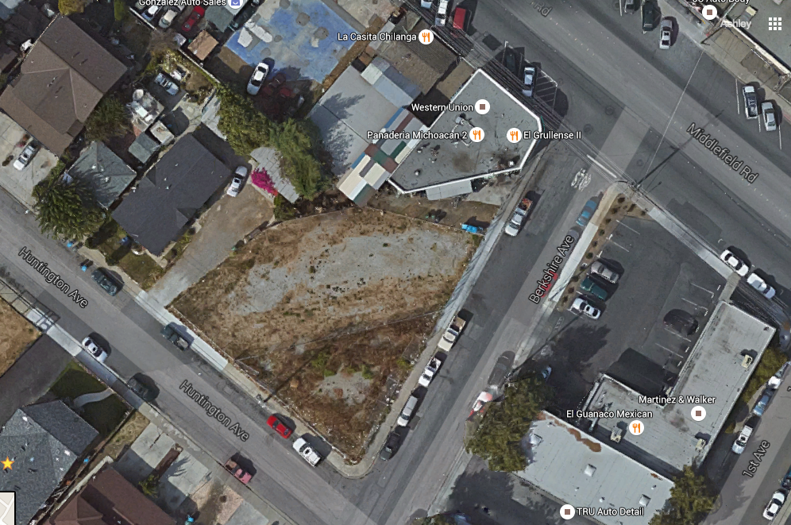
Vacant Lot Opportunities
Notes:
- Brief background on these dialogues
- Thanks to sponsors
- Describe dialogue purpose:
learn more about the topic of parks, gardens and green spaces
have an opportunity to share your thinking about this topic and hear from others what they think
consider how you can promote access to parks and green spaces in NFO
- Invite to next dialogue (August 12, 2015)

Slide 8
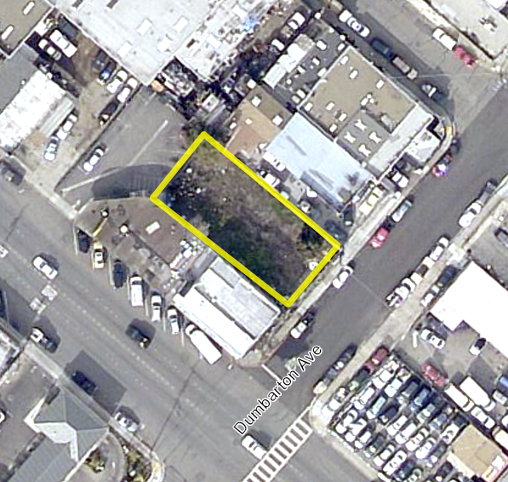
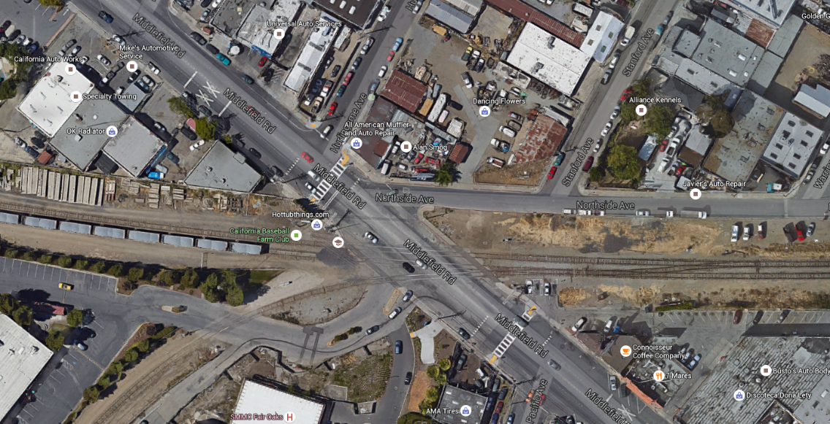
Middlefield Road and Dumbarton Ave
SamTrans Parcel

Slide 9
Shared Agreements
Text on business owner data…
(visual)
Sharing parking…

Slide 10

Commercial Vehicles – Residential Area
Notes:
- Brief background on these dialogues
- Thanks to sponsors
- Describe dialogue purpose:
learn more about the topic of parks, gardens and green spaces
have an opportunity to share your thinking about this topic and hear from others what they think
consider how you can promote access to parks and green spaces in NFO
- Invite to next dialogue (August 12, 2015)

Slide 11

Parking Enforcement
Notes:
- Brief background on these dialogues
- Thanks to sponsors
- Describe dialogue purpose:
learn more about the topic of parks, gardens and green spaces
have an opportunity to share your thinking about this topic and hear from others what they think
consider how you can promote access to parks and green spaces in NFO
- Invite to next dialogue (August 12, 2015)

Slide 12

QUESTIONS
Preguntas

Slide 13

Small Group
Grupo de Diálogo
Where do you currently park?
¿SPANISH?
What additional parking location can we explore on Middlefield Road?
¿SPANISH?
How do you believe parking on Middlefield Road should be handled?
¿SPANISH?

Slide 14
Small Group Highlights
Compartir sus opiniones

Slide 15


Thank You for attending!
Gracias por asistir
Contact Information:
Ashley Quintana, Outreach Coordinator
650.363.4048
aquintana@smcgov.org • www.nfoforward.org
THANK YOU FOR ATTENDING!
¡Gracias por asistir!

